Slide 1



Classification of Room Occupancy using a Convolutional Neural Network
Alessandro Amella
April 29, 2024

Slide 2

Preprocessing
Crop and resize images: scale to a uniform size
Convert image to np.array and normalize pixel values . pixel val / 255.0 => result ∈ [0, 1]
Encode labels: convert labels to one-hot encoding
Splitting data into training (80%) and validation (20%) sets

Slide 3
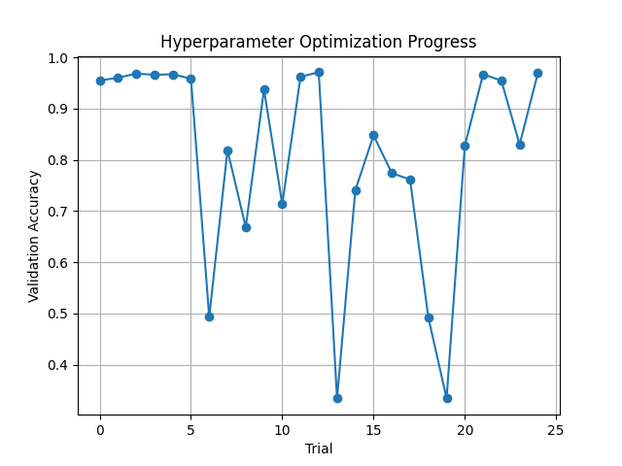
Hyperparameter Optimization
Utilized Optuna to optimize:
conv2d_filter: number of filters in convolutional layers
dense_units: number of neurons in a dense layer
dropout_rate: rate for dropout regularization
learning_rate: learning rate for Adam optimizer

Slide 4
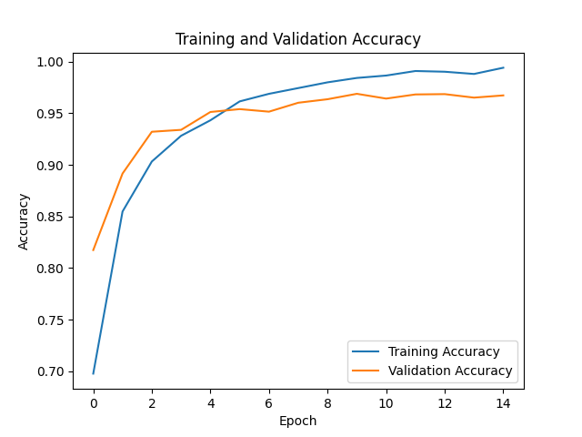
The final CNN Model
Used CNN for classification with:
Adam compiler
Categorical Cross-Entropy loss function
To limit overfitting:
Early stopping
Keras Pruning: prunes unpromising trials

Slide 5
Input Layer: expects color images with dimensions of 44x50 px
3 Conv2D layers for feature extraction using best_conv2d_filter
MaxPooling2D layer to shrink feature maps
Flatten layer to flatten output to 1D vector
Dense layer (fully connected) with best_dense_units neurons
Dropout rate with rate of best_dropout_rate
Output Dense layer of 4 neurons for 4 output classes

Slide 6
Image Augmentation
Explored image augmentation techniques
Rotation, flipping, scaling
Low accuracy on validation data, even with non-aggressive parameters
=> Overfitting
=> Original dataset already sufficiently diverse

Slide 7
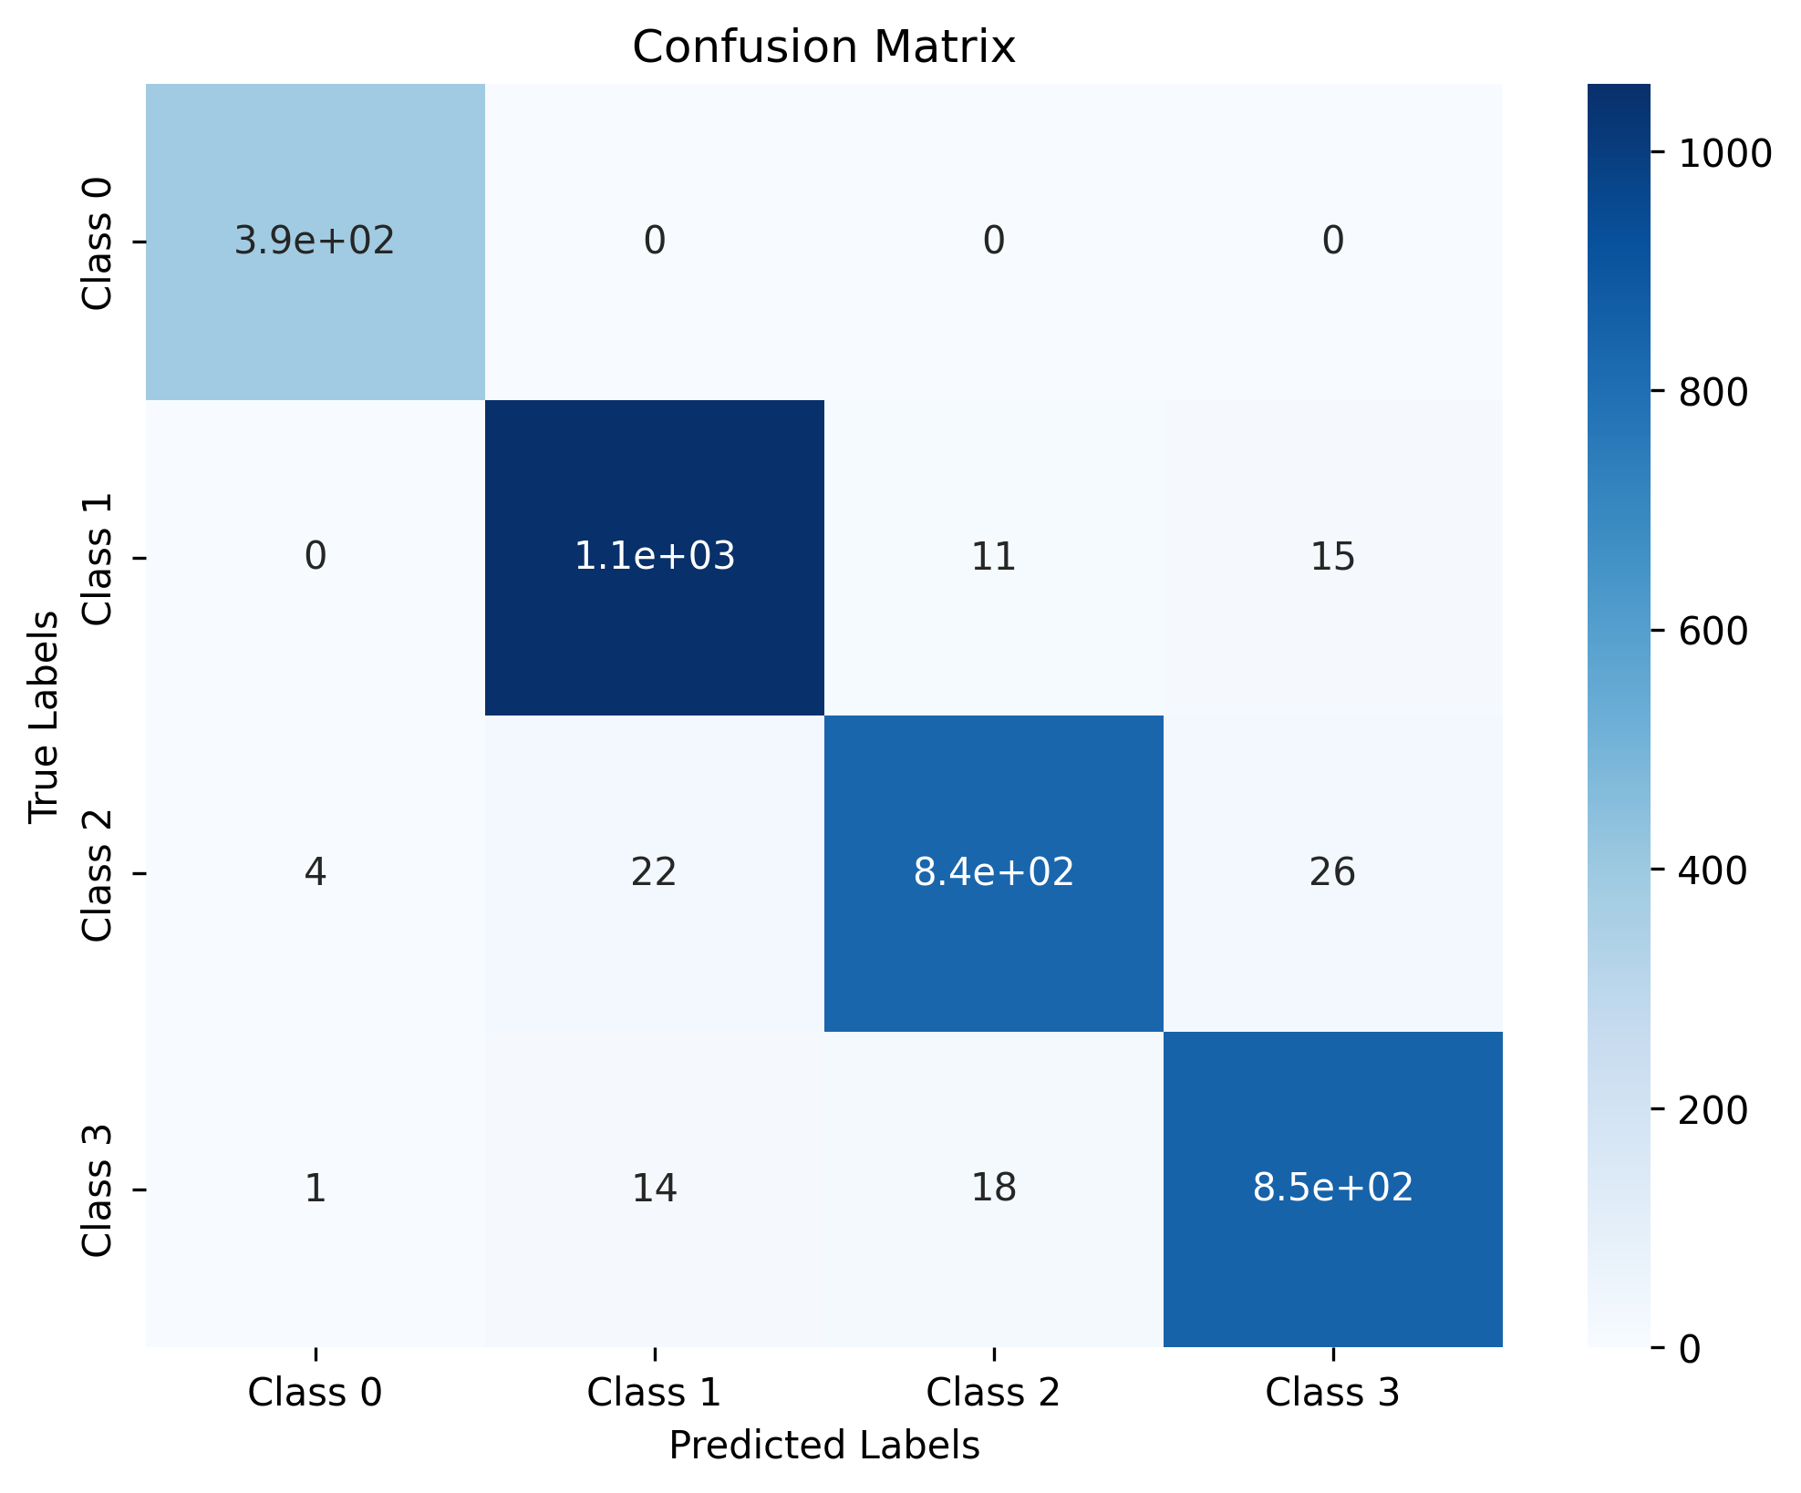
Results and Conclusion
After 50 epochs, the CNN model achieved a validation accuracy of 96.94% 🎉🎉
=> Good hyperparameter optimization by Optuna, good choice of architecture

